Slide 1
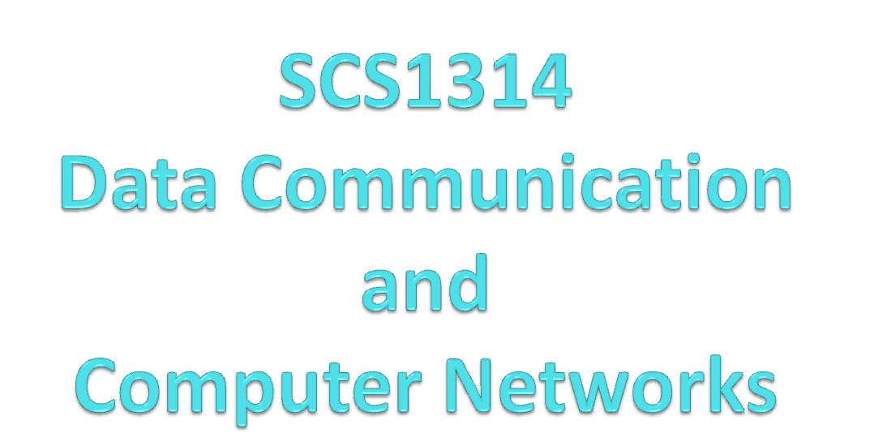

Slide 2
COURSE OBJECTIVES
Recognize the individual components of the big picture of computer
networks.
Outline the basic network configurations.
List the layers of the OSI model and Internet model and describe the duties of each layer.

Slide 3
Introduction
What is Data?
  Information ,message,..(may be text, video ,audio,numbers,….
What is communication?
  Exchange of data
Transmission medium
  Channel or path
What is Data Communication?
Data communications are the exchange of data between two or more devices via some form of transmission medium such as a wireless or wire cable.

Slide 4
Computer Networks
Networks
  A collection of people or things that are somehow related.
  In Computer networks
    The interconnected parts of computers, peripherals and other devices that communicate with one another.
    A Computer network may connect two or more computers

Slide 5
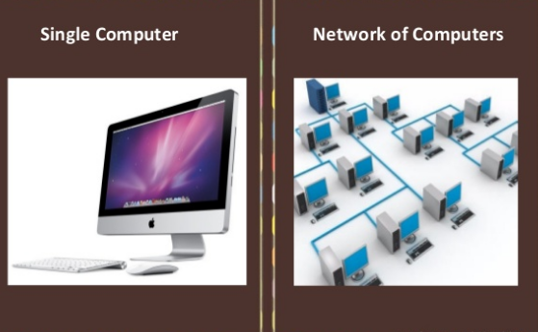
Computer Network

Slide 6
Why Network
Access Information
Exchange Information
Networks help people work faster and smarter

Slide 7
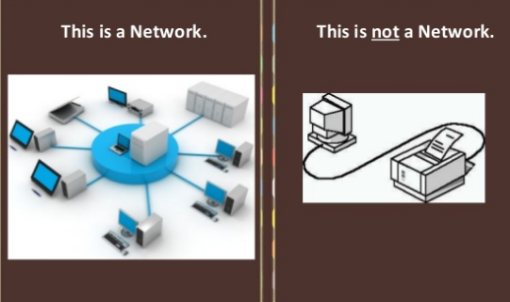
Computer Networks

Slide 8
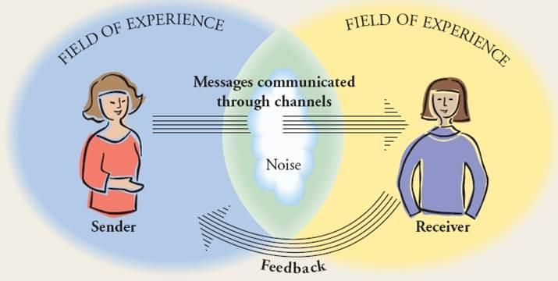
Person to person communication

Slide 9
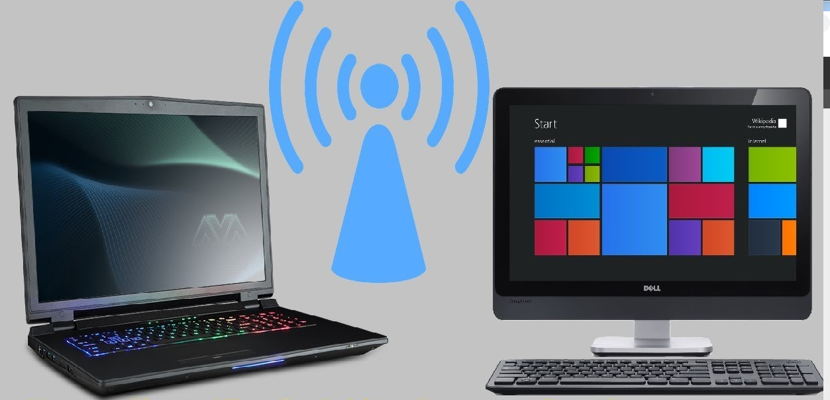
    Sender Receiver
    Analog Electromagnetic waves Analog
    0 1 110 000111
    Analog Analog

Slide 10
TEXT / REFERENCE BOOKS
1. Behrouz A. Fourouzan, “Data Communication and Networking”, McGraw-Hill Education India Pvt. Ltd - New Delhi.
2. William Stallings, Data and Computer Communications (8th ed.), Pearson Education, 2007.
3. P.C. Gupta, Data Communications and Computer Networks, Prentice-Hall of India, 2006.
4. Andrew S. Tanenbaum, “Computer Networks”, Fourth Edition, Pearson.
5. L. L. Peterson and B. S. Davie, Computer Networks: A Systems Approach (3rd ed.), Morgan Kaufmann, 2003.

Slide 11
Effective Characteristics of Data Communication
Delivery
  The system must deliver data to the correct destination
Accuracy (unchanged data)
  The system must deliver the data accurately. Data that have been altered in transmission and left uncorrected are unusable.
Timeliness
  The system must deliver data in a timely manner. Data delivered late are useless. In the case of video and audio, timely delivery means delivering data as they are produced, in the same order that they are produced, and without significant delay. This kind of delivery is called real-time transmission.
Jitter (uneven delay in audio/video streaming)
  Jitter refers to the variation in the packet arrival time. It is the uneven delay in the delivery of audio or video packets. For example, let us assume that video packets are sent every 3D ms. If some of the packets arrive with 3D-ms delay and others with 4D-ms delay, an uneven quality in the video is the result.

Slide 12
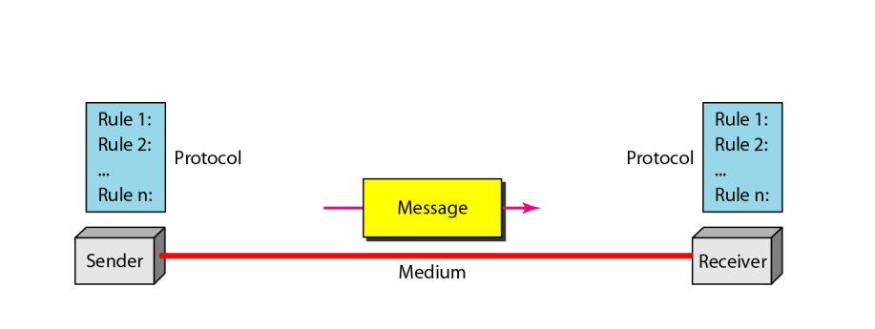
Five components of data communication
1. Message
2. Sender
3. Receiver
4. Transmission Medium
5. Protocol – Set of Rules and Regulation

Slide 13
Data flow direction
Simplex
Half-duplex
Full-duplex

Slide 14
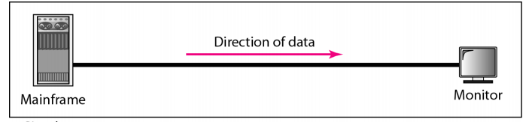
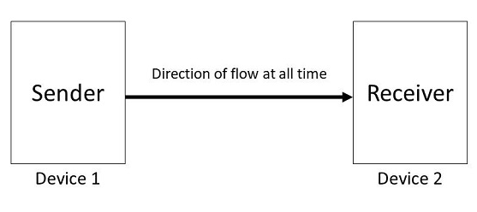
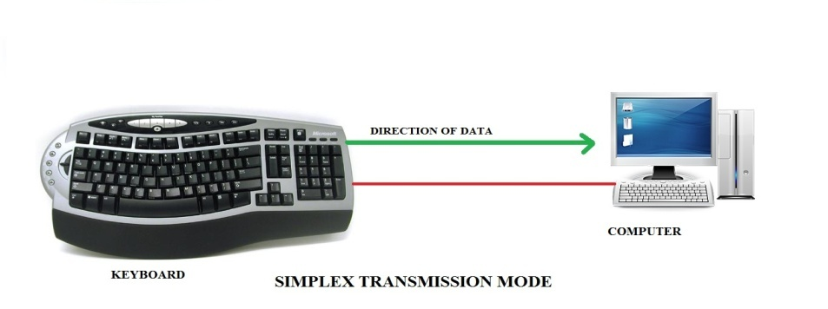
Simplex
Unidirectional
Sender can only send data
Example: Keyboard and monitor

Slide 15
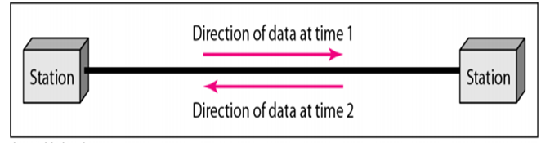

Half-duplex
Two-directional(bi- directional), one at a time
Sender can send and receive data, but one a time
Example: Walkie-talkie

Slide 16
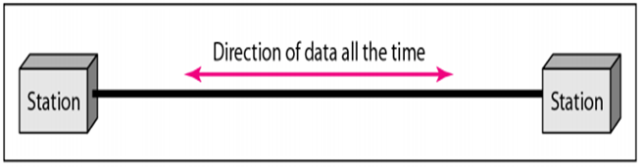

Full-duplex
Two-directional(bi- directional), simultaneously
Sender can send and receive data simultaneously
Example: Telephone

Slide 17
NETWORKS
A network is a set of devices (often referred to as nodes) connected by communication links.
A node can be a computer, printer, or any other device capable of sending and/or receiving data generated by other nodes on the network.

Slide 18
Network Criteria
Performance
  It is measured in terms of transit time and response time.
  Transit time is the time for a message to travel from one device to another
  Response time is the elapsed time between an inquiry and a response.
  Reliability
    Reliability is the measure of how often a network is useable
  Security
    Security is the protection of Hardware, Software and Data from unauthorized access.
    Anti-Virus are a security measure

Slide 19
Factors affecting Performance
Number of Users: More users on a network - slower the network will run
Transmission Speed: speed that data will be transmitted measured in bits per second (bps)
Type of transmission medium: Type of physical connection used to connect nodes together
Hardware Type: Slow computers such as XT or fast such as Pentiums(processor-Latest-core i5,i7,…)
Software Program: How well is the network operating system (NOS) written

Slide 20
Line Configuration
(connection)
A network is two or more devices connected through a link.
A link is a communication pathway that transfer data from one device to another.
Devices can be a computer, printer or any other device that is capable to send and receive data.
For visualization purpose, imagine any link as a line drawn between two points.
For communication to occur, two devices must be connected in some way to the same link at the same time
Types of connections
1. Point-to-point 2. Multipoint

Slide 21
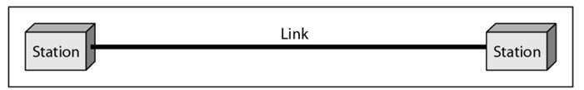
Point-to-point
A point-to-point connection provides a dedicated link between two devices.
The entire capacity of the link is reserved for transmission between those two devices.
Most point-to-point connections use a actual length of wire or cable to connect the two end, but other options such as microwave or satellite links are also possible.
It is also the simplest to establish and understand.
Example: Point-to-Point connection between remote control and Television for changing the channels.

Slide 22
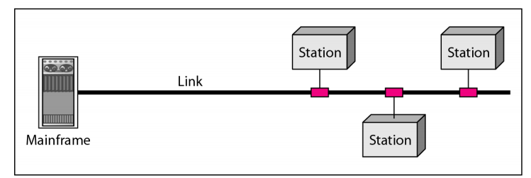
Multipoint
It is also called Multidrop configuration. In this connection two or more devices share a single link.
More than two devices share the link that is the capacity of the channel is shared now. With shared capacity, there can be two possibilities in a Multipoint Line configuration:
Spatial Sharing: If several devices can share the link simultaneously, its called Spatially shared line configuration.
Temporal (Time) Sharing: If users must take turns using the link , then its called Temporally shared or Time Shared Line configuration.

Slide 23
Topology
The arrangement of a network which comprises of nodes and connecting lines via sender and receiver is referred as network topology.
Or
Network topology is the arrangement of the elements (links,nodes, etc.) of a communication network.

Slide 24
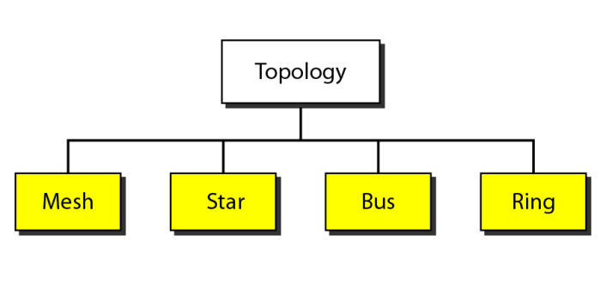
Categories of topology

Slide 25

Mesh Topology
In mesh topology, every device has dedicated point to point link with every other device .

Slide 26
Ports and Links
If suppose, N number of devices are connected with each other in mesh topology, then total number of ports that is required by each device is ? N-1.
In the above Figure, there are 5 devices connected to each other, hence total number of ports required in each device is 4.So total port is 20.
If suppose, N number of devices are connected with each other in mesh topology, then total number of dedicated links required to connect them is N(N-1)/2.
In the above Figure , there are 5 devices connected to each other, hence total number of links required is 5*4/2 = 10.

Slide 27
Advantages Mesh topology
No data traffic issues as there is a dedicated link between two devices which means the link is only available for those two devices.
Mesh topology is reliable and robust as failure of one link doesn’t affect other links and the communication between other devices on the network.
Mesh topology is secure because there is a point to point link thus unauthorized access is not possible.
Fault detection is easy.
Problems with this topology :
Installation and configuration is difficult.
Cost of cables are high as bulk wiring is required, hence suitable for less number of devices.
Cost of maintenance is high.

Slide 28

Star Topology
In star topology each device in the network is connected to a central device called hub.
Unlike Mesh topology, star topology doesn’t allow direct communication between devices, a device must have to communicate through hub.
If one device wants to send data to other device, it has to first send the data to hub and then the hub transmit that data to the designated device.

Slide 29
Advantages Star Topology
Less expensive because each device only need one I/O port and needs to be connected with hub with one link.
Easier to install
Less amount of cables required because each device needs to be connected with the hub only.
Robust, if one link fails, other links will work just fine.
Easy fault detection because the link can be easily identified.
Disadvantages of Star topology
If the concentrator (hub) on which the whole topology relies fails, the whole system will crash down.
Cost of installation is high.
Performance is based on the single concentrator i.e. hub.

Slide 30
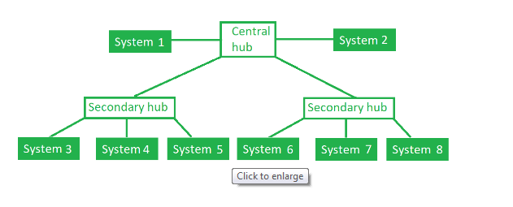
Tree Topology
This topology is the variation of Star topology. This topology have hierarchical flow of data.

Slide 31
Advantages
It allows more devices to be attached to a single central hub thus it increases the distance that is travel by the signal to come to the devices.
It allows the network to get isolate and also prioritize from different computers.
Problems with this topology :
If the central hub gets fails the entire system fails.
The cost is high because of cabling.

Slide 32

Bus Topology
In bus topology there is a main cable and all the devices are connected to this main cable through drop lines.
There is a device called tap that connects the drop line to the main cable.
Since all the data is transmitted over the main cable, there is a limit of drop lines and the distance a main cable can have.

Slide 33
Advantages
Easy installation, each cable needs to be connected with backbone cable.
Less cables required than Mesh and star topology
Disadvantages of bus topology
Difficultly in fault detection.
Not scalable as there is a limit of how many nodes you can connect with backbone cable.

Slide 34

Ring Topology
In ring topology each device is connected with the two devices on either side of it.
There are two dedicated point to point links a device has with the devices on the either side of it. This structure forms a ring thus it is known as ring topology.
If a device wants to send data to another device then it sends the data in one direction, each device in ring topology has a repeater, if the received data is intended for other device then repeater forwards this data until the intended device receives it

Slide 35
Advantages
Easy to install.
Managing is easier as to add or remove a device from the topology only two links are required to be changed.
Disadvantages of Ring Topology :
A link failure can fail the entire network as the signal will not travel forward due to failure.
Data traffic issues, since all the data is circulating in a ring.

Slide 36

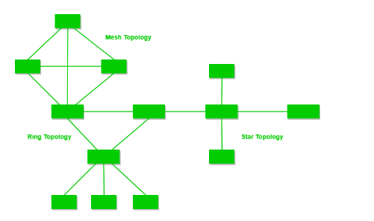
Hybrid Topology
A combination of two or more topology is known as hybrid topology. For example a combination of star and mesh topology is known as hybrid topology.

Slide 37
Advantages of Hybrid topology
1. We can choose the topology based on the requirement for example, scalability is our concern then we can use star topology instead of bus technology.
2. Scalable as we can further connect other computer networks with the existing networks with different topologies.
Disadvantages of Hybrid topology
1. Fault detection is difficult.
2. Installation is difficult.
3. Design is complex so maintenance is high thus expensive

Slide 38
Protocols And Standards
Protocols (rules)
what to communicate, how to communicate and when to
communicate
Key Elements of Protocols
1.Syntax - Structure of format of data
2.Semantics - Meaning of each section bits
3.Timing - When to send and how fast..

Slide 39
Network Standards
Networking standards define the rules for data communications that are needed for interoperability of networking technologies and processes.
Standards help in creating and maintaining open markets and allow different vendors to compete on the basis of the quality of their products while being compatible with existing market products.
During data communication, a number of standards may be used simultaneously at the different layers. The commonly used standards at each layer are −
Application layer − HTTP, HTML, POP, H.323, IMAP
Transport layer − TCP, SPX
Network layer −IP, IPX
Data link layer − Ethernet IEEE 802.3, X.25, Frame Relay
Physical layer −RS-232C (cable), V.92 (modem)

Slide 40
Standards
Agreed upon rule
A common set of rules
Categories of Standards
1.De facto - By convention or by fact
  These are the standards that are followed without any formal plan or approval by any organization.
  They have come into existence due to traditions or facts.
  For example, the HTTP had started as a de facto standard.
2.De jure - By Law or by Government
  These standards are the ones which have been adopted through legislation by any officially recognized standards organization.
  Most of the communication standards that are used today are de jure standards.

Slide 41
Standards Organizations
Some of the noted standards organizations are
International Standards Organization (ISO)
International Telecommunication Union (ITU)
Institute of Electronics and Electrical Engineers (IEEE)
American National Standards Institute (ANSI)
Internet Research Task Force (IETF)
Electronic Industries Association (EIA)

Slide 42
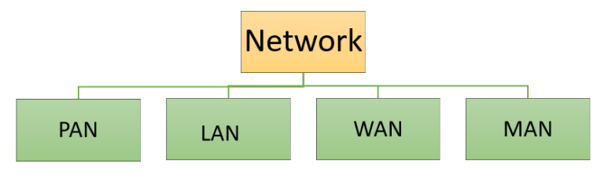
Categories of Networks
PAN covers very small area-0-10-m
LAN covers the smallest area -1 km(max)
MAN covers an area larger than LAN and - 50 km(city)
WAN comprises the largest of all- >50 km

Slide 43
PAN (Personal Area Network)
PAN is a computer network formed around a person.
It generally consists of a computer, mobile, or personal digital assistant.
PAN can be used for establishing communication among these personal devices for connecting to a digital network and the internet. Characteristics of PAN
It is mostly personal devices network equipped within a limited area.
Allows you to handle the interconnection of IT devices at the surrounding of a single user.
PAN includes mobile devices, tablet, and laptop.
It can be wirelessly connected to the internet called WPAN.
Appliances use for PAN: cordless mice, keyboards, and Bluetooth systems

Slide 44
Advantages & Disadvantages of PAN
Advantages of PAN
Here, are important pros/benefits of using PAN network:
PAN networks are relatively secure and safe
It offers only short-range solution up to ten meters
Strictly restricted to a small area
Disadvantages of PAN
Here are important cons/ drawback of using PAN network:
It may establish a bad connection to other networks at the same radio bands.
Distance limits.

Slide 45
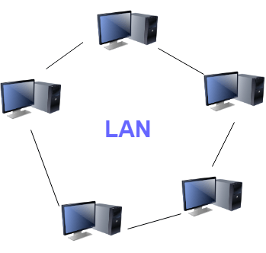
LAN(Local Area Network)
A Local Area Network (LAN) is a group of computer and peripheral devices which are connected in a limited area such as school, laboratory, home, and office building.
It is a widely useful network for sharing resources like files, printers, games, and other application.
The simplest type of LAN network is to connect computers and a printer in someone's home or office.
In general, LAN will be used as one type of transmission medium.
It is a network which consists of less than 5000 interconnected devices across several buildings.

Slide 46
Characteristics of LAN
Here are important characteristics of a LAN network:
It is a private network, so an outside regulatory body never controls it.
LAN operates at a relatively higher speed compared to other WAN systems.
There are various kinds of media access control methods like token ring and ethernet.

Slide 47
Advantages of LAN
Here are pros/benefits of using LAN:
Computer resources like hard-disks, DVD-ROM, and printers can share local area networks. This significantly reduces the cost of hardware purchases.
You can use the same software over the network instead of purchasing the licensed software for each client in the network.
Data of all network users can be stored on a single hard disk of the server computer.
You can easily transfer data and messages over networked computers.
It will be easy to manage data at only one place, which makes data more secure.
Local Area Network offers the facility to share a single internet connection among all the LAN users.

Slide 48
Disadvantages of LAN
Here are the important cons/ drawbacks of LAN:
LAN will indeed save cost because of shared computer resources, but the initial cost of installing Local Area Networks is quite high.
The LAN admin can check personal data files of every LAN user, so it does not offer good privacy.
Unauthorized users can access critical data of an organization in case LAN admin is not able to secure centralized data repository.
Local Area Network requires a constant LAN administration as there are issues related to software setup and hardware failures

Slide 49
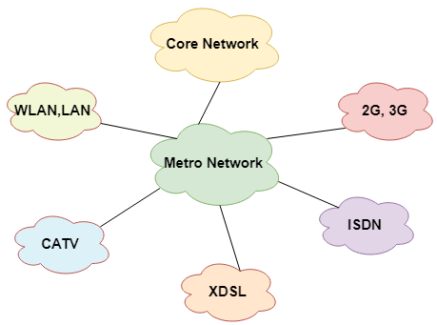
MAN(Metropolitan Area Network)
A Metropolitan Area Network or MAN is consisting of a computer network across an entire city, college campus, or a small region.
This type of network is large than a LAN, which is mostly limited to a single building or site. Depending upon the type of configuration, this type of network allows you to cover an area from several miles to tens of miles.

Slide 50
Characteristics of MAN
It mostly covers towns and cities in a maximum 50 km range
Mostly used medium is optical fibers, cables
Data rates adequate for distributed computing applications.

Slide 51
Advantages of MAN
It offers fast communication using high-speed carriers, like fiber optic cables.
It provides excellent support for an extensive size network and greater access to WANs.
The dual bus in MAN network provides support to transmit data in both directions concurrently.
A MAN network mostly includes some areas of a city or an entire city.
Disadvantages of MAN
Here are drawbacks/ cons of using the MAN network:
You need more cable to establish MAN connection from one place to another.
In MAN network it is tough to make the system secure from hackers

Slide 52
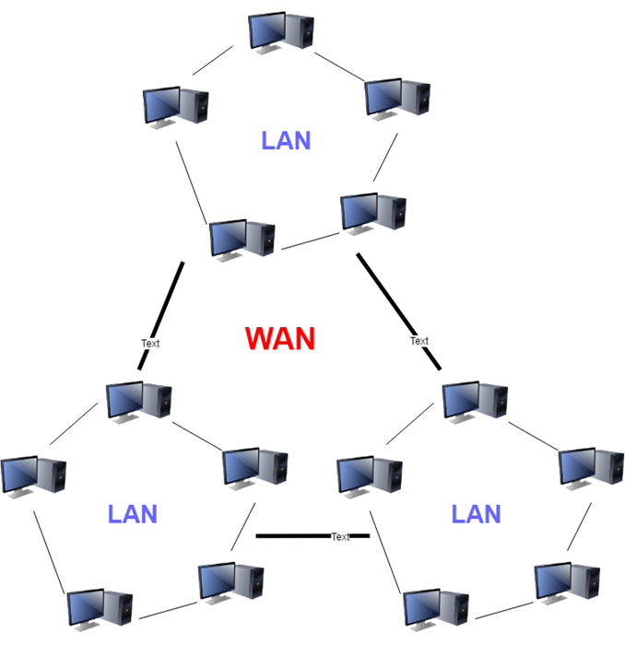
WAN(Wide Area Network)
WAN network system could be a connection of a LAN which connects with other LAN's using telephone lines and radio waves. It is mostly limited to an enterprise or an organization.

Slide 53
Advantages of WAN
Here are the benefits/ pros of using WAN:
WAN helps you to cover a larger geographical area. Therefore business offices situated at longer distances can easily communicate.
Contains devices like mobile phones, laptop, tablet, computers, gaming consoles, etc.
WLAN connections work using radio transmitters and receivers built into client devices.

Slide 54
Disadvantage of WAN
Here are drawbacks/cons of using WAN:
The initial setup cost of investment is very high.
It is difficult to maintain the WAN network. You need skilled technicians and network administrators.
There are more errors and issues because of the wide coverage and the use of different technologies.
It requires more time to resolve issues because of the involvement of multiple wired and wireless technologies.
Offers lower security compared to other types of networks.

Slide 55
Other Types of Networks
Apart from above mentioned here, are some other important types of networks:
WLAN (Wireless Local Area Network)
Storage Area Network
System Area Network
Home Area Network
POLAN- Passive Optical LAN
Enterprise private network
Campus Area Network
Virtual Area Network

Slide 56
Categories of Networks-Summary
LAN
Privately owned for office, home, buildings etc.
• limited to few kms.
resource sharing
generally one type of transmission medium
Speed
WLAN
WAN
Long distance transmission
either complex (Switched WAN) or simple (point to point WAN)
e.g. X.25 >> Frame Relay >> ATM
Wireless WAN
MAN
High speed, DSL, Cable TV network

Slide 57

WANs: a switched WAN and a point-to-point WAN

Slide 58

A heterogeneous network made of four WANs and two LANs

Slide 59
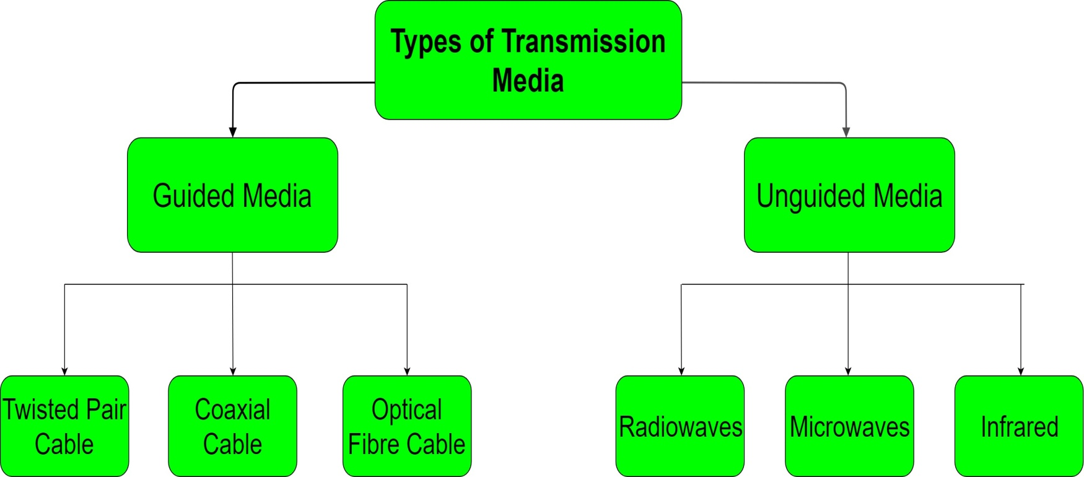
Transmission Media
is a physical path between the transmitter and the receiver
i.e it is the channel through which data is sent from one place to another.
Transmission Media is broadly classified into the following types:

Slide 60
1. Guided Media
It is also referred to as Wired or Bounded transmission media.
Guided media, which are those that provide a channel from one device to another.
Signals being transmitted are directed in a narrow pathway by using physical links.
Features:
High Speed
Secure
Used for comparatively shorter distances
There are 3 major types of Guided Media:
Twisted-pair and coaxial cable use metallic (copper) conductors that accept and transport signals in the form of electric current.
Optical fibre is a cable that accepts and transports signals in the form of light.

Slide 61
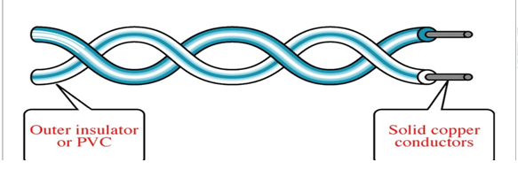
(i) Twisted Pair Cable
A twisted pair consists of two conductors(normally copper), each with its own plastic insulation, twisted together.
One of these wires is used to carry signals to the receiver, and the other is used only as ground reference.
The receiver uses the difference between the two.

Slide 62
Why twisted
In addition to the signal sent by the sender on one of the wires, interference(noise) and crosstalk may affect both wires and create unwanted signals.
To reduce crosstalk or electromagnetic induction between pairs of wires, two insulated copper wires are twisted around each other
This cable is the most commonly used and is cheaper than others.
It is lightweight, cheap, can be installed easily, and they support many different types of network.
Some important points :
Its frequency range is 0 to 3.5 kHz.
Typical attenuation is 0.2 dB/Km @ 1kHz.
Typical delay is 50 µs/km.
Repeater spacing is 2km.

Slide 63
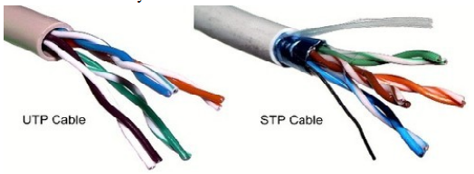
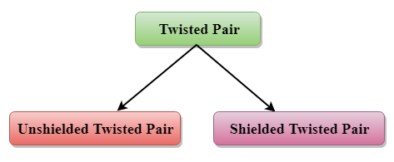
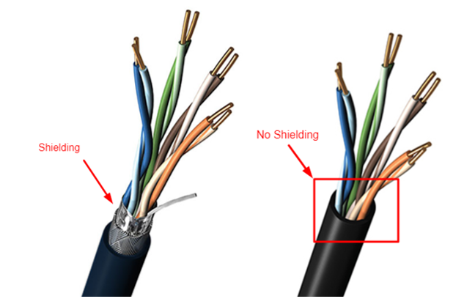
Types of Twisted Pair
Shielded(STP) and unshielded(UTP)
UTP
STP

Slide 64
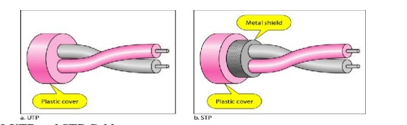
Shielded(STP) and unshielded(UTP)

Slide 65
Unshielded Twisted Pair (UTP)
It is the most common type of telecommunication when compared with Shielded Twisted Pair Cable which consists of two conductors usually copper, each with its own colour plastic insulator. Identification is the reason behind coloured plastic insulation.
UTP cables consist of 2 or 4 pairs of twisted cable. Cable with 2 pair use RJ-11 connector and 4 pair cable use RJ-45 connector.
This type of cable has the ability to block interference and does not depend on a physical shield for this purpose. It is used for telephonic applications.
Advantages:
  Least expensive
  Easy to install
  High speed capacity
Disadvantages:
  Susceptible to external interference
  Lower capacity and performance in comparison to STP(low BW)
  Short distance transmission due to attenuation

Slide 66
Shielded Twisted Pair (STP)
This type of cable consists of a special jacket to block external interference. It is used in fast-data-rate Ethernet and in voice and data channels of telephone lines.
Advantages:
Easy to install
Performance is adequate
Can be used for Analog or Digital transmission
Increases the signalling rate
Higher capacity than unshielded twisted pair
Eliminates crosstalk
Disadvantages:
Comparitively difficult to install and manufacture
More expensive
Bulky

Slide 67
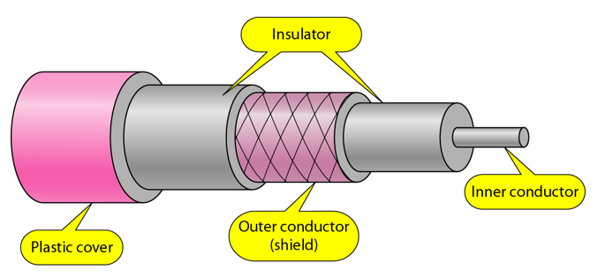
(ii) Coaxial Cable
Coaxial is called by this name because it contains two conductors that are parallel to each other.
Copper is used in this as centre conductor which can be a solid wire or a standard one.
It is surrounded by PVC installation, a sheath which is encased in an outer conductor of metal foil, barid or both.
Outer metallic wrapping is used as a shield against noise and as the second conductor which completes the circuit.
The outer conductor is also encased in an insulating sheath.
The outermost part is the plastic cover which protects the whole cable.

Slide 68
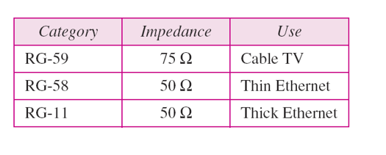
Coaxial Cable Standards
Coaxial cables are categorized by their Radio Government(RG) ratings.
Each RG number denotes a unique set of physical specifications, including the wire gauge of the inner conductor, the thickness and the type of the inner insulator, the construction of the shield, and the size and type of the outer casing.
Each cable defined by an RG rating is adapted for a specialized function, as shown in the table below:

Slide 69
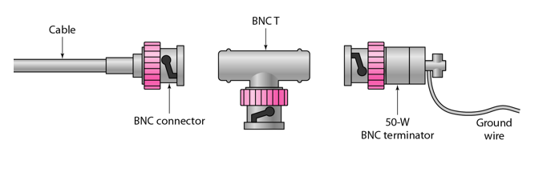
Coaxial Cable Connectors
To connect coaxial cable to devices, we need coaxial connectors.
The most common type of connector used today is the Bayonet Neill-Concelman (BNC) connector.
The below figure shows 3 popular types of these connectors:
the BNC Connector, the BNC T connector and the BNC terminator.
The BNC connector is used to connect the end of the cable to the device, such as a TV set.
The BNC T connector is used in Ethernet networks to branch out to a connection to a computer or other device.
The BNC terminator is used at the end of the cable to prevent the reflection of the signal.

Slide 70
Types Of Coaxial Cables
1. BaseBand
This is a 50 ohm (Ω) coaxial cable which is used for digital transmission. It is mostly used for LAN's.
Baseband transmits a single signal at a time with very high speed.
The major drawback is that it needs amplification after every 1000 feet.
2. BroadBand
This uses analog transmission on standard cable television cabling.
It transmits several simultaneous signal using different frequencies.
It covers large area when compared with Baseband Coaxial Cable.

Slide 71
Advantages and Disadvantages of Coaxial Cable
Advantages of Coaxial Cable
Bandwidth is high
Used in long distance telephone lines.
Transmits digital signals at a very high rate of 10Mbps.
Much higher noise immunity
Data transmission without distortion.
The can span to longer distance at higher speeds as they have better shielding when compared to twisted pair cable
Disadvantages of Coaxial Cable
Single cable failure can fail the entire network.
Difficult to install and expensive when compared with twisted pair.
If the shield is imperfect, it can lead to grounded loop.

Slide 72
Applications of Coaxial Cable
Coaxial cable was widely used in analog telephone networks, where a single coaxial network could carry 10,000 voice signals.
Cable TV networks also use coaxial cables. In the traditional cable TV network, the entire network used coaxial cable. Cable TV uses RG-59 coaxial cable.
In traditional Ethernet LANs. Because of it high bandwidth, and consequence high data rate, coaxial cable was chosen for digital transmission in early Ethernet LANs.
The 10Base-2, or Thin Ethernet, uses RG-58 coaxial cable with BNC connectors to transmit data at 10Mbps with a range of 185 m.

Slide 73
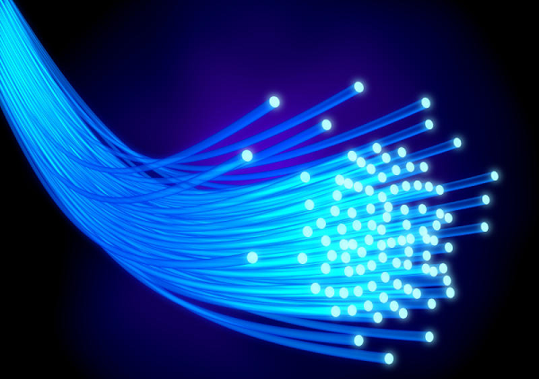
(iii) Optical Fibre Cable
A fibre-optic cable is made of glass or plastic and transmits signals in the form of light.

Slide 74
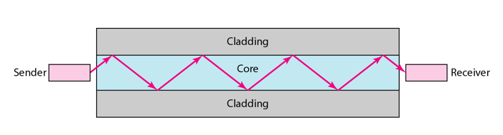
Internal view of an Optical fibre
Optical fibres use reflection to guide light through a channel.
A glass or plastic core is surrounded by a cladding of less dense glass or plastic.
The difference in density of the two materials must be such that a beam of light moving through the core is reflected off the cladding instead of being refracted into it.

Slide 75
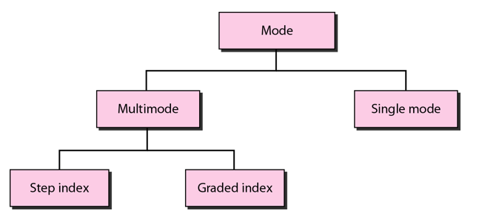
Propagation Modes of Fiber Optic Cable

Slide 76
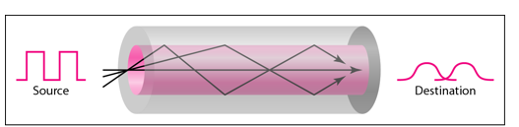
Multimode Propagation Mode
Multimode is so named because multiple beams from a light source move through the core in different paths.
In multimode step-index fibre, the density of the core remains constant from the centre to the edges.
A beam of light moves through this constant density in a straight line until it reaches the interface of the core and the cladding.
The term step-index refers to the suddenness of this change, which contributes to the distortion of the signal as it passes through the fibre.

Slide 77
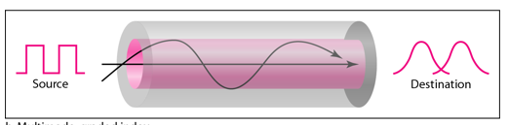
In multimode graded-index fibre, this distortion gets decreases through the cable.
The word index here refers to the index of refraction.
This index of refraction is related to the density.
A graded-index fibre, therefore, is one with varying densities.
Density is highest at the centre of the core and decreases gradually to its lowest at the edge.

Slide 78
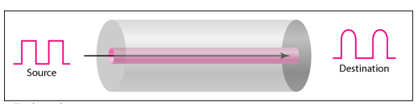
Single Mode
Single mode uses step-index fibre and a highly focused source of light that limits beams to a small range of angles, all close to the horizontal.
The single-mode fibre itself is manufactured with a much smaller diameter than that of multimode fibre, and with substantially lower density.
The decrease in density results in a critical angle that is close enough to 90 degree to make the propagation of beams almost horizontal.

Slide 79
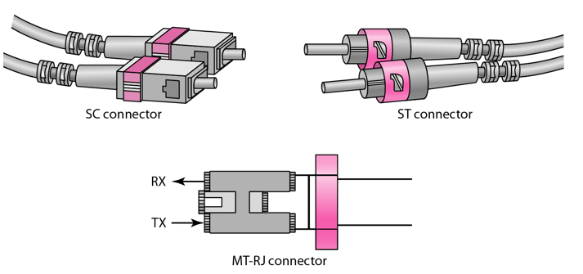
Fibre Optic Cable Connectors
There are three types of connectors for fibre-optic cables.
The Subscriber Channel(SC) connector is used for cable TV. It uses push/pull locking system.
The Straight-Tip(ST) connector is used for connecting cable to the networking devices.
MT-RJ is a connector that is the same size as RJ45.

Slide 80
Advantages of Fibre Optic Cable
Higher bandwidth
Less signal attenuation
Immunity to electromagnetic interference
Resistance to corrosive materials
Light weight
Greater immunity to tapping
Disadvantages of Fibre Optic Cable
Installation and maintenance
Unidirectional light propagation
High Cost

Slide 81
Applications of Fibre Optic Cable
Often found in backbone networks because its wide bandwidth is cost-effective.
Some cable TV companies use a combination of optical fibre and coaxial cable thus creating a hybrid network.
Local-area Networks such as 100Base-FX network and 1000Base-X also use fibre-optic cable.

Slide 82
Unguided Media
It is also referred to as Wireless or Unbounded transmission media.
No physical medium is required for the transmission of electromagnetic signals.
Features:
Signal is broadcasted through air
Less Secure
Used for larger distances

Slide 83
Types of Unguided Media
(i)Radiowaves
These are easy to generate and can penetrate through buildings. The sending and receiving antennas need not be aligned.
Frequency Range:3KHz – 1GHz. AM and FM radios and cordless phones use Radiowaves for transmission.
Further Categorized as (i) Terrestrial and (ii) Satellite.
(ii)Microwaves
It is a line of sight transmission i.e. the sending and receiving antennas need to be properly aligned with each other.
The distance covered by the signal is directly proportional to the height of the antenna.
Frequency Range:1GHz – 300GHz. These are majorly used for mobile phone communication and television distribution.
(iii)Infrared
Infrared waves are used for very short distance communication.
They cannot penetrate through obstacles. This prevents interference between systems.
Frequency Range:300GHz – 400THz. It is used in TV remotes, wireless mouse, keyboard, printer, etc.

Slide 84
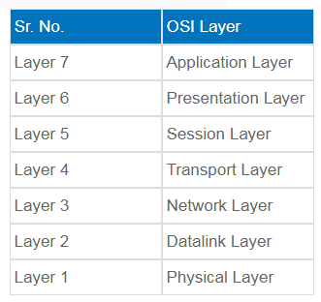
OSI model
The International Standards Organisation (ISO) has proposed a reference model that covers all the aspects of network communication across all types of computer systems. This model is called the Open System Interconnect (OSI) model.
The OSI Model is a layered architecture consisting of seven layers.

Slide 85
1. Physical Layer (Layer 1)
The lowest layer of the OSI reference model is the physical layer. It is responsible for the actual physical connection between the devices. The physical layer contains information in the form ofbits. It is responsible for transmitting individual bits from one node to the next. When receiving data, this layer will get the signal received and convert it into 0s and 1s and send them to the Data Link layer, which will put the frame back together.
The functions of the physical layer are :
Bit synchronization: The physical layer provides the synchronization of the bits by providing a clock. This clock controls both sender and receiver thus providing synchronization at bit level.
Bit rate control: The Physical layer also defines the transmission rate i.e. the number of bits sent per second.
Physical topologies: Physical layer specifies the way in which the different, devices/nodes are arranged in a network i.e. bus, star or mesh topolgy.
Transmission mode: Physical layer also defines the way in which the data flows between the two connected devices. The various transmission modes possible are: Simplex, half-duplex and full-duplex.

Slide 86
2. Data Link Layer (DLL) (Layer 2)
The data link layer is responsible for the node to node delivery of the message. The main function of this layer is to make sure data transfer is error-free from one node to another, over the physical layer. When a packet arrives in a network, it is the responsibility of DLL to transmit it to the Host using its MAC address.
Data Link Layer is divided into two sub layers :
Logical Link Control (LLC)
Media Access Control (MAC)
The packet received from Network layer is further divided into frames depending on the frame size of NIC(Network Interface Card). DLL also encapsulates Sender and Receiver’s MAC address in the header.
The Receiver’s MAC address is obtained by placing an ARP(Address Resolution Protocol) request onto the wire asking “Who has that IP address?” and the destination host will reply with its MAC address.

Slide 87
The functions of the data Link layer are :
Framing: Framing is a function of the data link layer. It provides a way for a sender to transmit a set of bits that are meaningful to the receiver. This can be accomplished by attaching special bit patterns to the beginning and end of the frame.
Physical addressing: After creating frames, Data link layer adds physical addresses (MAC address) of sender and/or receiver in the header of each frame.
Error control: Data link layer provides the mechanism of error control in which it detects and retransmits damaged or lost frames.
Flow Control: The data rate must be constant on both sides else the data may get corrupted thus , flow control coordinates that amount of data that can be sent before receiving acknowledgement.
Access control: When a single communication channel is shared by multiple devices, MAC sub-layer of data link layer helps to determine which device has control over the channel at a given time.

Slide 88
3. Network Layer (Layer 3)
Network layer works for the transmission of data from one host to the other located in different networks. It also takes care of packet routing i.e. selection of the shortest path to transmit the packet, from the number of routes available. The sender & receiver’s IP address are placed in the header by the network layer.
The functions of the Network layer are :
Routing: The network layer protocols determine which route is suitable from source to destination. This function of network layer is known as routing.
Logical Addressing: In order to identify each device on internetwork uniquely, network layer defines an addressing scheme. The sender & receiver’s IP address are placed in the header by network layer. Such an address distinguishes each device uniquely and universally.

Slide 89
4. Transport Layer (Layer 4)
Transport layer provides services to application layer and takes services from network layer. The data in the transport layer is referred to as Segments. It is responsible for the End to End Delivery of the complete message. The transport layer also provides the acknowledgement of the successful data transmission and re-transmits the data if an error is found.
• At sender’s side:
Transport layer receives the formatted data from the upper layers, performs Segmentation and also implements Flow & Error control to ensure proper data transmission. It also adds Source and Destination port number in its header and forwards the segmented data to the Network Layer.
At receiver’s side:
Transport Layer reads the port number from its header and forwards the Data which it has received to the respective application. It also performs sequencing and reassembling of the segmented data.
Transport Layer is called as Heart of OSI model.

Slide 90
The functions of the transport layer are :
Segmentation and Reassembly: This layer accepts the message from the (session) layer , breaks the message into smaller units . Each of the segment produced has a header associated with it. The transport layer at the destination station reassembles the message.
Service Point Addressing: In order to deliver the message to correct process, transport layer header includes a type of address called service point address or port address. Thus by specifying this address, transport layer makes sure that the message is delivered to the correct process.
The services provided by the transport layer :
Connection Oriented Service: It is a three-phase process which include
– Connection Establishment
– Data Transfer
– Termination / disconnection
In this type of transmission, the receiving device sends an acknowledgement, back to the source after a packet or group of packet is received. This type of transmission is reliable and secure.
Connection less service: It is a one-phase process and includes Data Transfer. In this type of transmission, the receiver does not acknowledge receipt of a packet. This approach allows for much faster communication between devices. Connection-oriented service is more reliable than connectionless Service.

Slide 91
5. Session Layer (Layer 5)
This layer is responsible for establishment of connection, maintenance of sessions, authentication and also ensures security.
The functions of the session layer are :
Session establishment, maintenance and termination: The layer allows the two processes to establish, use and terminate a connection.
Synchronization : This layer allows a process to add checkpoints which are considered as synchronization points into the data. These synchronization point help to identify the error so that the data is re-synchronized properly, and ends of the messages are not cut prematurely and data loss is avoided.
Dialog Controller : The session layer allows two systems to start communication with each other in half-duplex or full-duplex.

Slide 92
6. Presentation Layer (Layer 6)
Presentation layer is also called the Translation layer.The data from the application layer is extracted here and manipulated as per the required format to transmit over the network.
The functions of the presentation layer are :
Translation : For example, ASCII to EBCDIC.
Encryption/ Decryption : Data encryption translates the data into another form or code. The encrypted data is known as the cipher text and the decrypted data is known as plain text. A key value is used for encrypting as well as decrypting data.
Compression: Reduces the number of bits that need to be transmitted on the network.

Slide 93
7. Application Layer (Layer 7)
At the very top of the OSI Reference Model stack of layers, we find Application layer which is implemented by the network applications. These applications produce the data, which has to be transferred over the network. This layer also serves as a window for the application services to access the network and for displaying the received information to the user.
Ex: Application – Browsers, Skype Messenger etc.
**Application Layer is also called as Desktop Layer
The functions of the Application layer are :
Network Virtual Terminal
FTAM-File transfer access and management
Mail Services
Directory Services

